Slide 1
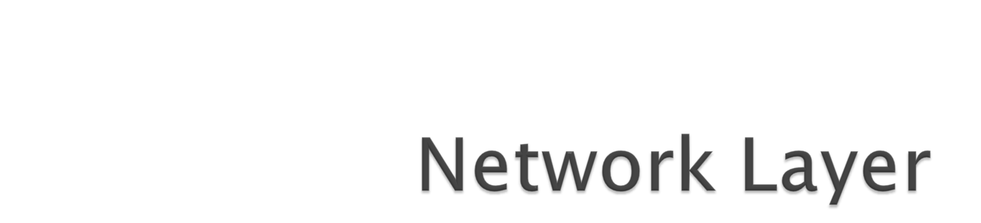
Prof. Tasneem Mirza

Slide 2
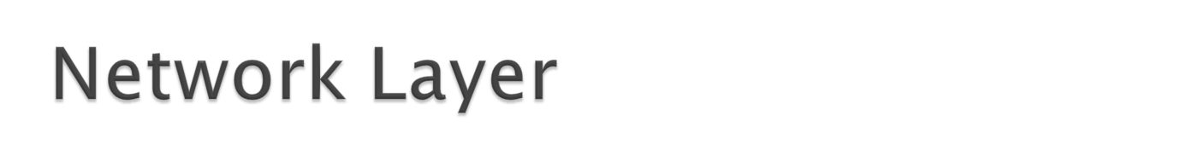
Function:
  Route packets end-to-end on a network, through multiple hops
Key challenge:
  How to represent addresses
  How to route packets
Application
Presentation
Session
Transport
Network
Data Link
Physical

Slide 3
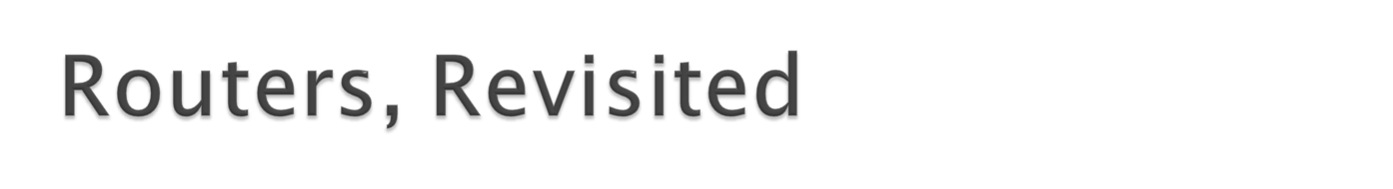



How to connect multiple LANs?
LANs may be incompatible
  Ethernet, Wifi, etc…
Connected networks form an internetwork
  The Internet is the best known example
Routers

Slide 4
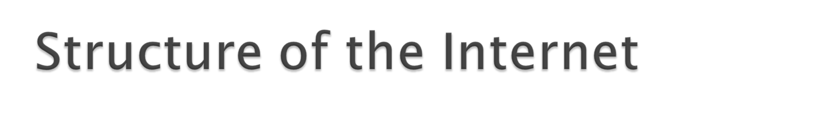
Network 3
Network 1
Network 4
Network 2
Ad-hoc interconnection of networks
  No organized topology
  Vastly different technologies, link capacities
Packets travel end-to-end by hopping through networks
  Routers “peer” (connect) different networks
  Different packets may take different routes

Slide 5
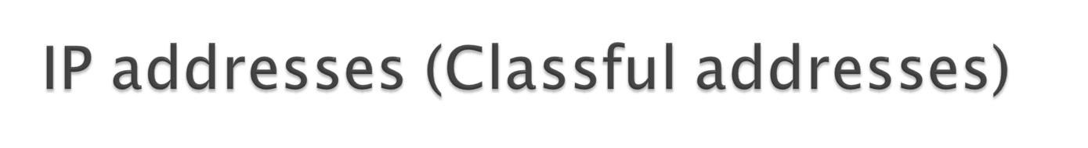
To allow global communication each device on the internet is identified by an IP address.
IP address---→ 32 bit (unique)

Slide 6

An IP address is 32-bit long.
  It is usually written as four decimal numbers separated by
  dots (periods) (dotted decimal notation)
  In hex, each of the four hexadecimal numbers is called an
  octet.
  Example: 137.207.192.03 or 89 CF C0 03
  An IP address contains a network part and a host part.
  The number of address bits used to identify the network,
  and the number to identify the host, vary according to
  the class of the address.
  Routers or gateways have one or more addresses
  (depending on the no. of links they have) The three main
  address classes are class A, class B, and class C.

Slide 7
IPv4: 32-bit addresses
Hierarchical address scheme
  Separate the address into a network and a host
  Usually written in dotted notation, e.g. 192.168.21.76
  Each number is a byte
0
8
16
24
31
Decimal
192
168
21
76
Hex
C0
A8
15
4C
Binary
11000000
10101000
00010101
01001100

Slide 8


Find the error, if any, in the following IPv4 addresses.
Solution
a. There must be no leading zero (045).
b. There can be no more than four numbers.
c. Each number needs to be less than or equal to 255.
d. A mixture of binary notation and dotted-decimal
notation is not allowed.

Slide 9
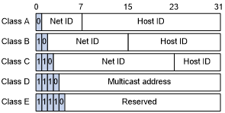

Slide 10


Slide 11


Slide 12
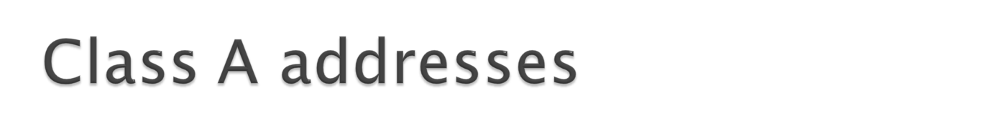
Consists of 128 different net ids
First net id covers addresses(host ids) from
0.0.0.0 to 0.255.255.255 (netd id 0)
Second net id covers addresses(host ids) from
1.0.0.0 to 1.255.255.255 (netd id 1)
Third net id covers addresses(host ids) from
2.0.0.0 to 2.255.255.255 (netd id 2)
Last net id covers addresses(host ids) from
127.0.0.0 to 127.255.255.255 (netd id 127)

Slide 13
The first address in each block is called the network address
Eg : 73.0.0.0
Designed for large organizations with a large number of in the network.
Each net id contains 2^24 addresses

Slide 14
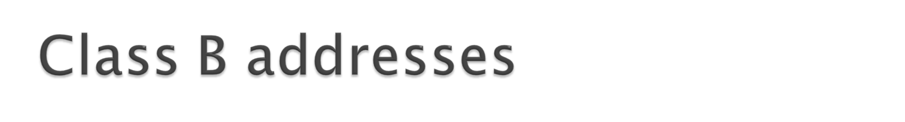
Consists of 2^14(16384) different net ids.
The first netid in class B will be 128.0
The second netid in class B will be 128.1
Next 128.2
-
-
Next 128.255
Next 129.0
-
Next 129.255
-
Last net id 191.255

Slide 15
The first netid in class B 128.0 can have host addresses from 128.0.0.0 to
128.0.255.255
The last netid in class B 191.255 can have host addresses from 191.255.0.0 to
191.255.255.255
Total 16,384 organizations can have class B addresses
Each organization can have 65,536(2^16) hosts

Slide 16
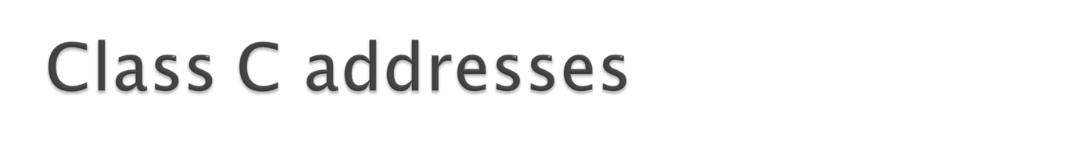
Consists of 2²¹ (2097152) netids
The first netid in class C will be 192.0.0
The second netid in class C will be 192.0.1
Next 192.0.2
-
Next 192.0.255
Next 192.1.0
-
Next 192.255.255
-
Last net id 223.255.255

Slide 17
The first netid in class C 192.0.0 can have host addresses from 192.0.0.0 to 192.0.0.255
The last netid in class C 223.255.255 can have host addresses from 223.255.255.0 to
223.255.255.255
Each netid contains 256 addresses

Slide 18
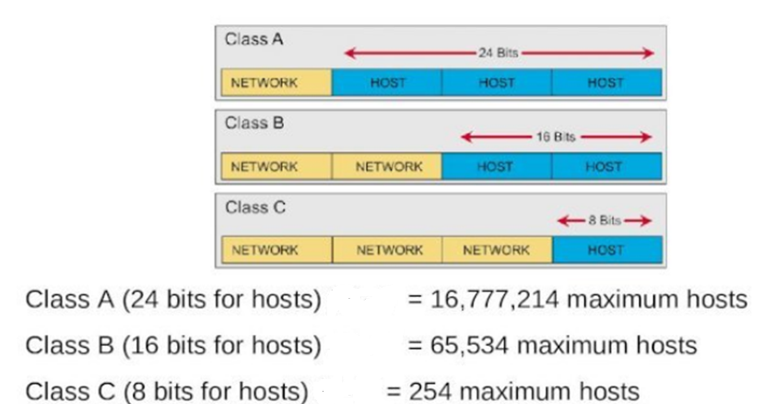

Slide 19
Find the class of each address.
a. 00000001 00001011 00001011 11101111
b. 11000001 10000011 00011011 11111111
c. 14.23.120.8
d. 252.5.15.111
Solution
a. The first bit is 0. This is a class A address.
b. The first 2 bits are 1; the third bit is 0. This is a class C
address.
c. The first byte is 14; the class is A.
d. The first byte is 252; the class is E.

Slide 20
Given a n/w address 132.12.0.0. Find the class, netid and range of addresses
Class B
Net id -132.12
Range 132.12.0.0 – 132.12.255.255

Slide 21
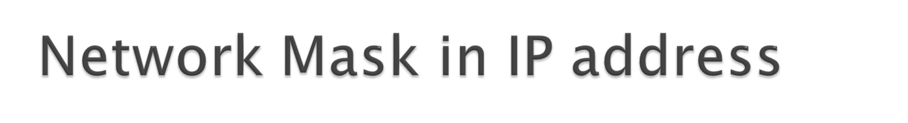
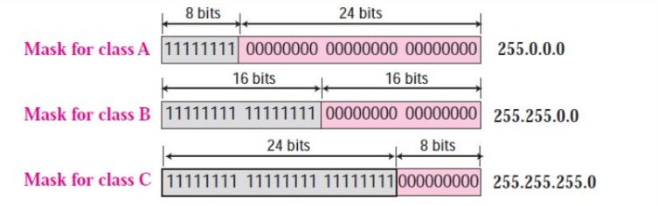

Slide 22
From an address given , how to find the network address---→
Soln
Use a mask to find the network address
AND operation of the mask and the address gives the network address
E g: Add : 23.56.7.91
Find the network address -----------→
Default mask : 255.0.0.0
Network Address : 23.0.0.0

Slide 23
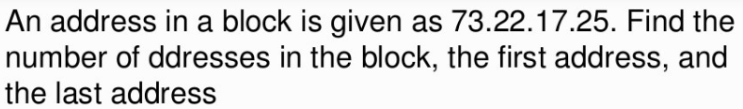
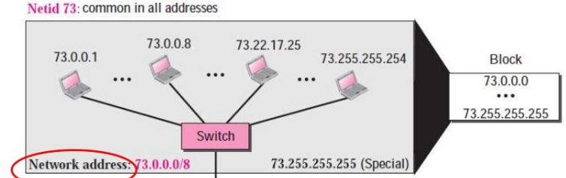
Eg :

Slide 24
An address in a block is given as 180.8.17.9. find the number of addresses in the block(netid), the first address, and the last address.
180 falls between 128 and 191 and therefore, the class of the address is B
Therefore, the number of addresses is 2 raised to the power of (32-16), i.e., 16.
Hence 2 raised to 16 works out as 65,536.
To get the first address, we retain the leftmost 16 bits and set the rightmost 16 bits to 0s.
Therefore, the first address is 180.8.0.0/16
For finding the last address, we will keep the leftmost 16 bits and set the rightmost 16 bits to 1s.
Hence, the last address is 180.8.255.255.

Slide 25


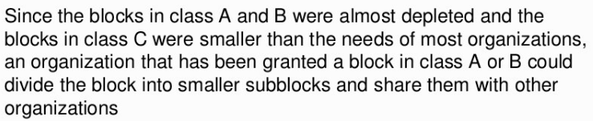

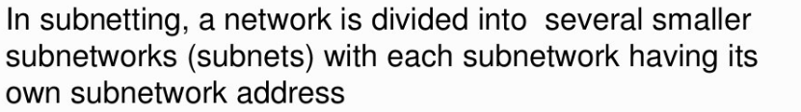

Slide 26

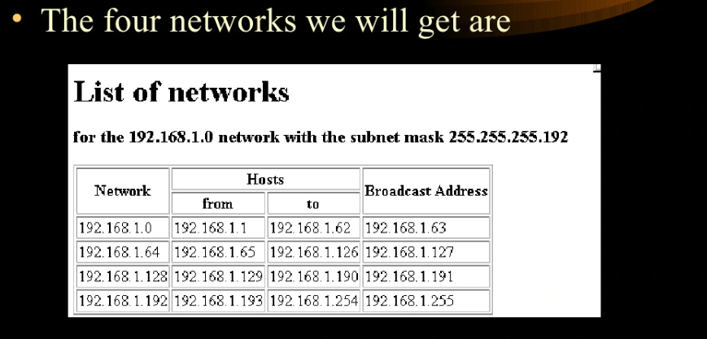
Lets assume network 192.168.1.0 has to be divided into 4 subnets.

Slide 27
Sub Network | From | To | Broadcast Add
192.168.1.0 | 192.168.1.00000001 | 192.168.1.00111110 | 192.168.1.63
192.168.1.64 | 192.168.1.01000001 | 192.168.1.01111110 | 192.168.1.127
192.168.1.128 | 192.168.1.10000001 | 192.168.1.10111110 | 192.168.1.191
192.168.1.192 | 192.168.11000001 | 192.168.1.11111110 | 192.168.1.255
Subnet mask 255.255.255.192

Slide 28
When a network is subnetted we have a subnet mask
The network mask gives a n/w address
The subnet mask gives a Subnet address
AND of ip address and subnet mask gives the subnet id
Eg : For the said numerical find the subnet id of 192.168.1.12.
Subnet mask : 255.255.255.192
Ans :192.168.1.0

Slide 29
Figure shows the same network in after subnetting.
The whole network is still connected to the Internet through the same router.
However, the network has used a private router to divide the network into four subnetworks.
The rest of the Internet still sees only one network; internally the network is made of four subnetworks.
Each subnetwork can now have almost 2¹⁴ hosts.
The network can belong to a university campus with four different schools (buildings).
After subnetting, each school has its own subnetworks, but still the whole campus is one network for the rest of the Internet. Note that /16 and /18 show the length of the netid and subnetids.

Slide 30
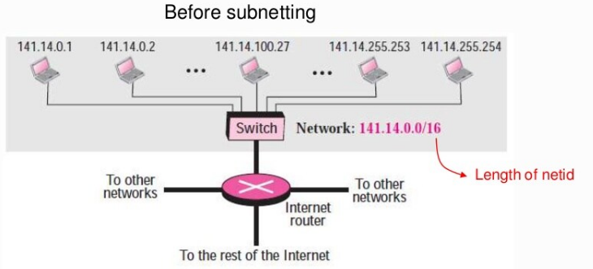
Hosts are organized into groups. Each group is called a subnet

Slide 31
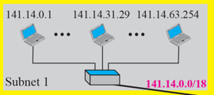
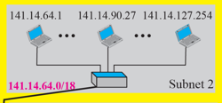
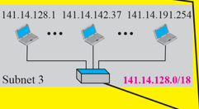
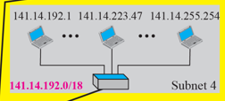
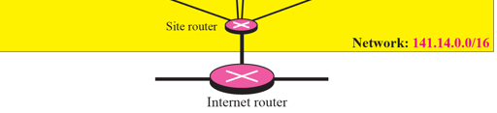
Subnetting

Slide 32
Adding subnetworks creates an intermediate level of hierarchy in the Ip addressing.
IP address-----------→ 3 levels
Byte1 Byte 2 Byte 3 Byte 4
Net id Subnet id Host id
When a network is subnetted we have a subnet mask
The network mask gives a n/w address
The subnet mask gives a Subnet address
Default mask
255.255.0.0
141.14.72.24
IP address
AND
141.14.0.0

Slide 33
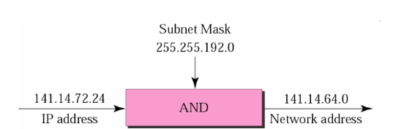
What is the subnetwork address if the destination address is 141.14.72.24 and the subnet mask is 255.255.192.0 ?

Slide 34
Ex
Let’s take a class IP address - 172.35.10.0/17
First, check what will be network address of this IP Address.
That will be 172.35.0.0 (because in class B two octets are reserved for networks and two for hosts.)
17 that means subnet Mask =
Write /17 in bits form,
11111111.11111111. 10000000.00000000
Now convert it into binary. That will be equal to 255.255.128.0
For Number of subnets,
Number of subnets = 2^no of subnetted bits
In our case no of subnetted bits is 1
Because IP address that we are using here belongs to Class B
No of subnetted bits =
17-16=1.
So, we will get 2 subnets from /17
No. of host per subnet
2^15

Slide 35
Ex 1
Find the subnetwork address for a host with the IP address 210.15.15.68/28?
(HINT : Find the subnet mask)
Which class?
Class C
How many 1 ‘s in the subnet mask?
28
Subnet mask in binary?
11111111 11111111 11111111 11110000(255.255.255.240)
4 1’s in the host id
i.e Total 16 subnets
255.255.255.240 AND 210.15.15.68 =
subnetwork address for a host with the IP address 210.15.15.68 is 210.15.15.64

Slide 36
Ex 2
Consider an IP address of 198.168.182.10/29. How many hosts can have IP addresses in each subnet?
Subnet mask :
11111111.11111111.11111111.11111000
Totally – 32 subnets – Each subnet has 8 IP addresses
Number of hosts machines that can have IP addresses in each subnet –
8-2(Excluding first and last ) =
6

Slide 37
Ex 3
To create 6 subnets with 20 host, the classful subnet mask will be
255.255.255.224

Slide 38
Ex : 4
You have a class B network 182.16.0.0/22 which is subnetted . What is the subnet mask ?
11111111.11111111.11111100.00000000
The subnet mask is
255.255.252.0

Slide 39
Ex : 5
You have a class B network 162.12.0.0/19 which is subnetted, How may subnets can be created ?
8
Ex : 6
A router receives a packet with the destination address 132.7.21.84. Find the network address of the packet.
132.7.0.0

Slide 40
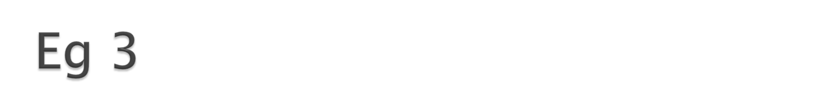
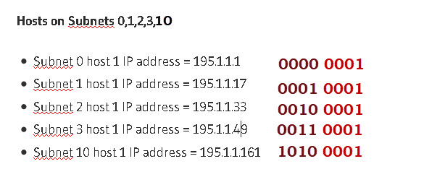
Subnet the Class C IP Address 195.1.1.0 So that you have 10 subnets each with a maximum 12 hosts on each subnet. List the Address to the first host machine on subnet 0,1,2,3,10.
Current mask= 255.255.255.0
Bits needs for 10 subnets =4 =2⁴ =16 possible subnets
Bits needs for 12 hosts = 4 = 2⁴ = 16-2=14 possible hosts.
So our mask in binary =11110000= 240 decimal
Subnet Mask =255.255.255.240

Slide 41
4. Subnet the Class C IP Address 195.1.1.0 So that you have at least 2 subnets each subnet must have room for 48 hosts .
What are the two possible subnet masks?
Current mask= 255.255.255.0
Bits needs for 48 hosts = 6 = 2⁶ = 64-2=62 possible hosts.
Bits needs for 2 subnets =1 =2¹ =2 possible subnets
Total of 7 bits needed so therefore we can use either 1 bit or 2 bits for the subnet. So we could have
1 bit subnet 7 bits hosts or 2 bits subnet 6 bit host
Masks are 10000000 and 11000000 =128 decimal and 192 decimal.
Final possible masks are:
255.255.255.128 and 255.255.255.192

Slide 42
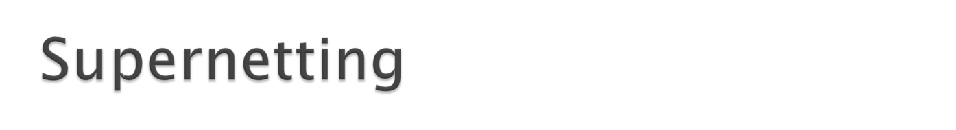
Class C --- max no. of addresses possible= 256 addresses.
Insufficient for an organization which needs more than 256 addresses.
Supernetting – Combine several Class C net ids(blocks) to create a larger no of addresses.
Several networks are combined to form a supernet
Eg : Organizations needs 1000 addresses

Slide 43
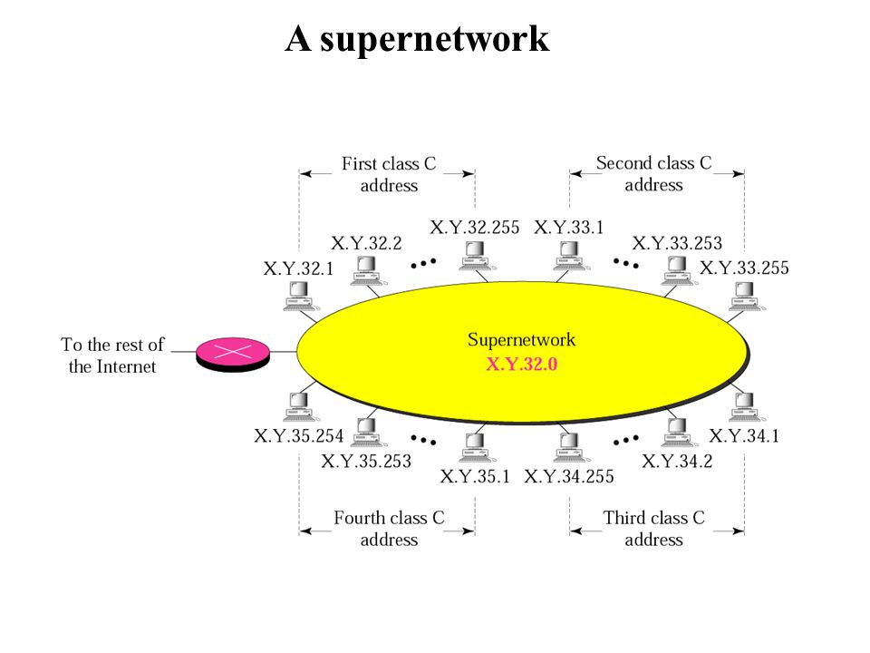

Slide 44
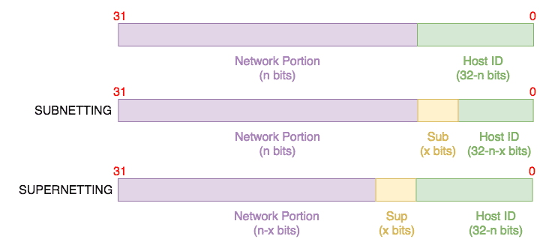

Slide 45
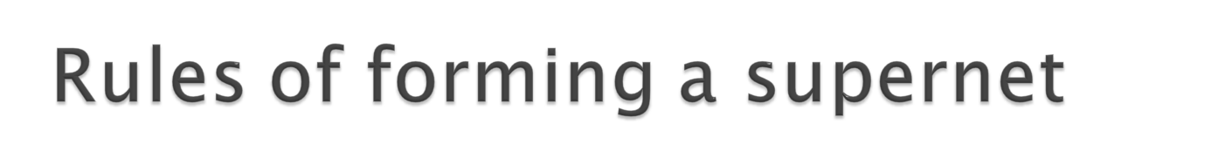
1.The networks must be contiguous in the address space
2.The number of blocks must be a power of 2
3. First Network id should be exactly divisible by whole size of supernet

Slide 46
List 1 | List 2 | List 3 | List 4
192.168.0.0/24 | 192.168.1.0/24 | 192.168.0.0/24 | 192.168.0.0/24
192.168.1.0/24 | 192.168.2.0/24 | 192.168.1.0/24 | 192.168.1.0/24
 |  | 192.168.2.0/24 | 192.168.2.0/24
 |  |  | 192.168.4.0/24
Apply the rules to each list and if any one of the rules is broken, then we cannot create one supernet for all those networks without causing some issues.

Slide 47
Rule #1: Contiguous networks
The networks in List 1 are contiguous because the next subnet after 192.168.0.0 is 192.168.1.0. Qualifies for next round.
The networks in List 2 are contiguous because the next subnet after 192.168.1.0 is 192.168.2.0. Qualifies for next round.
The networks in List 3 are contiguous because the next subnet after 192.168.0.0 is 192.168.1.0 and after that is 192.168.2.0. Qualifies for next round.
The networks in List 4 are not contiguous because the next subnet after 192.168.2.0 is 192.168.4.0, not 192.168.3.0. Does not qualify for next round.

Slide 48
Rule #2: Number of networks order of 2
There are two networks to be aggregated in List 1 which is an order of 2. Qualifies for next round.
There are two networks to be aggregated in List 2 which is an order of 2. Qualifies for next round.
There are three networks to be aggregated in List 3 which is not an order of 2. Does not qualify for next round.

Slide 49
Rule #3: Value of non-common octet in first IP block is divisible by size of the supernet
Or First Network id should be exactly divisible by whole size of supernet
The first (lowest) IP address block is 192.168.0.0.
The total size of the supernet is 2^8 *2 = 2^9
If last 9 bits of first IP address are zero then IP will be divisible.
Qualifies to be aggregated.
The first (lowest) IP address block is 192.168.1.0.
The total size of the supernet is 2^8 *2 = 2^9
If last 9 bits of first IP address are not zero
Does not qualify to be aggregated.
Therefore, only Lists 1 can be aggregated into one supernet

Slide 50
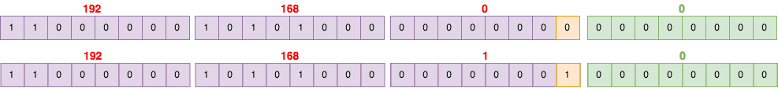
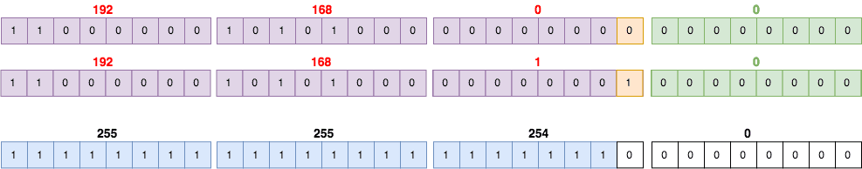
How-To: Supernetting
Once you have gone through the rules of supernetting above, you can now aggregate the networks by determining which of their bits are common and making all other bits from that point 0.
For example, let’s consider our List 1 above made up of 192.168.0.0 and 192.168.1.0:
These two networks are the same all the way to the 23rd block (counting from the left side starting at 1). The 24th block is where the difference is (highlighted in orange). Therefore, the subnet mask of the new supernet will be 1 all the way to the 23rd block and then 0 from there:
Finally, the supernet will be the first IP block in the list (192.168.0.0) with the
new supernet mask 255.255.254.0 or 192.168.0.0/23.

Slide 51
Example – Suppose 4 small networks of class C:
200.1.0.0 , 200.1.1.0 , 200.1.2.0 , 200.1.3.0 ,
First, let’s check whether three conditions are satisfied or not:
Contiguous: All networks are contiguous all having size 256 hosts.
Number of networks order of 2 - Satisfied
n the given example first IP is 200.1.0.0 and whole size of supernet is 4*2⁸ = 2¹⁰. If last 10 bits of first IP address are zero then IP will be divisible.
Hence networks can be aggregated.

Slide 52
A company needs 600 addresses. Which of the following set of class C blocks can be used to form a supernet for this company?
a. 198.47.32.0 198.47.33.0 198.47.34.0
b. 198.47.32.0 198.47.42.0 198.47.52.0 198.47.62.0
c. 198.47.31.0 198.47.32.0 198.47.33.0 198.47.52.0
d. 198.47.32.0 198.47.33.0 198.47.34.0 198.47.35.0
a.Not acceptable; there are only three blocks. We need at least four blocks to make the number of blocks a power of 2.
b. Not acceptable; the blocks are not contiguous.
c. Not acceptable; first IP address not divisible by total size of supernet
d. Acceptable; all three requirements are fulfilled. The company is given more addresses than it needs, but we do not have any other choice
Ans : 198.47.32.0 198.47.33.0 198.47.34.0 198.47.35.

Slide 53
We need to make a supernetwork out of 16 class C blocks. What is the supernet mask?
We need 16 blocks. For 16 blocks we need to change
four 1s to 0s in the default mask.
So the mask is
11111111 11111111 11110000 00000000

Slide 54
Ex
A supernet has a first address of 205.16.32.0 and a supernet mask of 255.255.248.0. How many blocks are in this supernet?
The supernet has 21 1s.
The default mask has 24 1s. Since the difference is 3, there are 23 or 8 blocks in this supernet.
The blocks are 205.16.32.0 to 205.16.39.0.
The first address is 205.16.32.0. The last address is 205.16.39.255

Slide 55
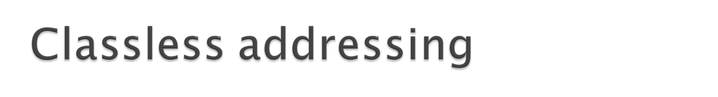
Classless Addressing is an improved IP Addressing system.
It makes the allocation of IP Addresses more efficient.
It replaces the older classful addressing system based on classes.
It is also known as Classless Inter Domain Routing (CIDR).
CIDR Block-
When a user asks for specific number of IP Addresses,
CIDR dynamically assigns a block of IP Addresses based on certain rules.
This block contains the required number of IP Addresses as demanded by the user.
This block of IP Addresses is called as a CIDR block.

Slide 56
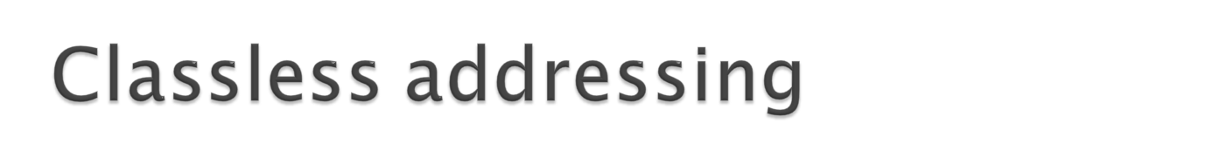
Rules For Creating CIDR Block-
A CIDR block is created based on the following 3 rules-
Rule-01:
All the IP Addresses in the CIDR block must be contiguous.
Rule-02:
The size of the block must be presentable as power of 2.
Size of the block is the total number of IP Addresses contained in the block.
Size of any CIDR block will always be in the form 2¹, 2², 2³, 2⁴, 2⁵ and so on.
Rule-03:
First IP Address of the block must be divisible by the size of the block.
So, any binary pattern is divisible by 2^n, if and only if its least
significant n bits are 0.

Slide 57
Examples-
Consider a binary pattern-
01100100.00000001.00000010.01000000
(represented as 100.1.2.64)
It is divisible by 2⁵ since its least significant 5 bits are zero.
It is divisible by 2⁶ since its least significant 6 bits are zero.
It is not divisible by 2⁷ since its least significant 7 bits are not zero.

Slide 58
CIDR Notation
CIDR IP Addresses look like-
a.b.c.d / n
They end with a slash followed by a number called as IP network prefix.
IP network prefix tells the number of bits used for the identification of network.
Remaining bits are used for the identification of hosts in the network.
An example of CIDR IP Address is-
182.0.1.2 / 28
28 bits are used for the identification of network.
Remaining 4 bits are used for the identification of hosts in the network.

Slide 59
Example
The following addresses are defined using slash notations.
a. In the address 12.23.24.78/8, the network mask is 255.0.0.0. The mask has eight 1s and twenty-four 0s. The prefix length is 8; the suffix length is 24.
b. In the address 130.11.232.156/16, the network mask is 255.255.0.0. The mask has sixteen 1s and sixteen 0s.The prefix length is 16; the suffix length is 16.
c. In the address 167.199.170.82/27, the network mask is 255.255.255.224. The mask has twenty-seven 1s and five 0s. The prefix length is 27; the suffix length is 5.

Slide 60
Example
One of the addresses in a block is 167.199.170.82/27. Find the number of addresses in the network, the first address, and the last address.
Solution
The value of n is 27. The network mask has twenty-seven 1s and five 0s. It is 255.255.255.224.
a. The number of addresses in the network is 2^{32 − n} = 32.
b. We use the AND operation to find the first address (network address). The first address is 167.199.170.64/27.

Slide 61
Problem-01:
Given the CIDR representation 20.10.30.35 / 27. Find the range of IP Addresses in the CIDR block.
Solution-
Given CIDR representation is 20.10.30.35 / 27.
27 bits are used for the identification of network.
Remaining 5 bits are used for the identification of hosts in the network.
Given CIDR IP Address may be represented as-
00010100.00001010.00011110.00100011 / 27
First IP Address = 00010100.00001010.00011110.00100000 = 20.10.30.32
Last IP Address = 00010100.00001010.00011110.00111111 = 20.10.30.63
Thus, Range of IP Addresses = [ 20.10.30.32 , 20.10.30.63]

Slide 62
Problem-02:
Consider a block of IP Addresses ranging from 100.1.2.32 to 100.1.2.47.
Is it a CIDR block? If yes, give the CIDR representation.
Solution-
For any given block to be a CIDR block, 3 rules must be satisfied-
Rule-01:
According to Rule-01, all the IP Addresses must be contiguous.
Clearly, all the given IP Addresses are contiguous.
So, Rule-01 is satisfied.
Rule-02:
According to Rule-02, size of the block must be presentable as 2^{n}.
Number of IP Addresses in the given block = 47 – 32 + 1 = 16.
Size of the block = 16 which can be represented as 2⁴.
So, Rule-02 is satisfied.

Slide 63
Rule-03:
According to Rule-03, first IP Address must be divisible by size of the block.
So, 100.1.2.32 must be divisible by 2⁴.
100.1.2.32 = 100.1.2.00100000 is divisible by 2⁴ since its 4 least significant bits are zero.
So, Rule-03 is satisfied.
Since all the rules are satisfied, therefore given block is a CIDR block.
CIDR Representation-
We have-
Size of the block = Total number of IP Addresses = 2⁴.
To have 2⁴ total number of IP Addresses, total 4 bits are required in the Host ID part.
So, Number of bits present in the Network ID part = 32 – 4 = 28.
CIDR representation : CIDR Representation = 100.1.2.32 / 28

Slide 64
Consider a block of IP Addresses ranging from 150.10.20.64 to 150.10.20.127. Is it a CIDR block?
If yes, give the CIDR representation.
Solution-
For any given block to be a CIDR block, 3 rules must be satisfied-
Rule-01:
According to Rule-01, all the IP Addresses must be contiguous.
Clearly, all the given IP Addresses are contiguous.
So, Rule-01 is satisfied.
Rule-02:
According to Rule-02, size of the block must be presentable as 2^{n}.
Number of IP Addresses in given block = 127 – 64 + 1 = 64.
Size of the block = 64 which can be represented as 2⁶.
So, Rule-02 is satisfied.
Rule-03:
According to Rule-03, first IP Address must be divisible by size of the block.
So, 150.10.20.64 must be divisible by 2⁶.
150.10.20.64 = 150.10.20.01000000 is divisible by 2⁶ since its 6 least significant bits are zero.
So, Rule-03 is satisfied.
Since all the rules are satisfied, therefore given block is a CIDR block.

Slide 65
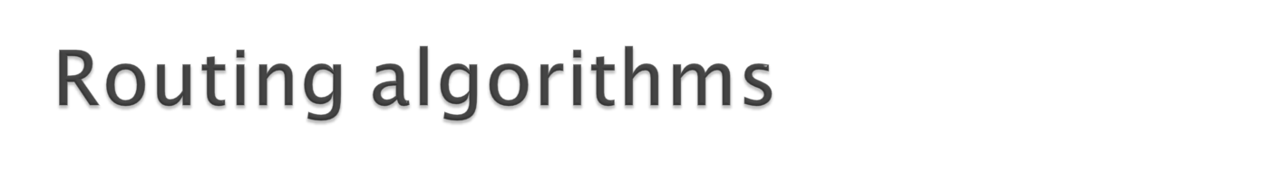
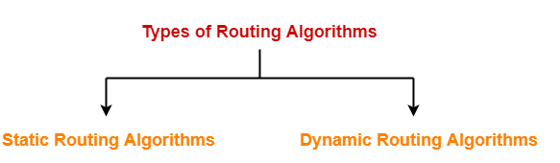
Routing algorithms are meant to determine optimal routing paths.
Routing table-→
records optimal routes.
Is consulted when a forwarding decision is to be made.
Routing algorithms are classified as-
Static/Non adaptive : Do not base their routing decision based on current traffic / topology.
Dynamic/Adaptive :Change their routing decision to reflect
changes in topology and traffic.

Slide 66
Distance Vector Routing Algorithm
Distance Vector Routing is a dynamic routing algorithm.
Step-01:
Each router prepares its routing table. By their local knowledge. each router knows about-
All the routers present in the network
Distance to its neighboring routers
Step-02:
Each router exchanges its distance vector with its neighboring routers.
Each router prepares a new routing table using the distance vectors it has obtained from its neighbors.
This step is repeated for (n-2) times if there are n routers in the network.
After this, routing tables converge / become stable.

Slide 67
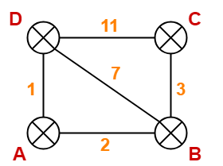
Distance Vector Routing Example-
Consider-
There is a network consisting of 4 routers.
The weights are mentioned on the edges.
Weights could be distances or costs or delays.
Step-01:
Each router prepares its routing table using its local knowledge.
Routing table prepared by each router is shown below-

Slide 68
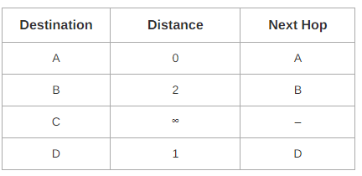
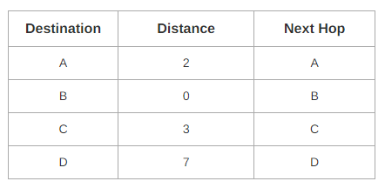
At Router A-
At Router B-

Slide 69
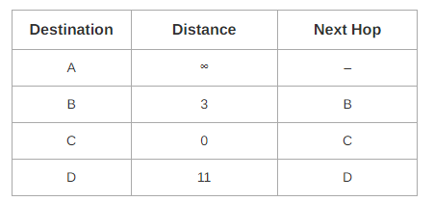
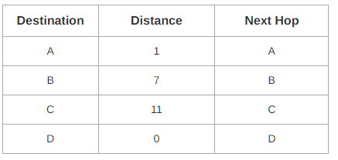
At Router C-
At Router D-

Slide 70
Step-02:
Each router exchanges its distance vector obtained in Step-01 with its neighbors.
After exchanging the distance vectors, each router prepares a new routing table.
This is shown below-
At Router A-
Router A receives distance vectors from its neighbors B and D.
Router A prepares a new routing table as-

Slide 71

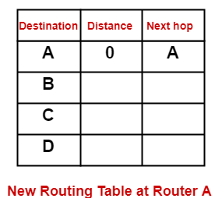


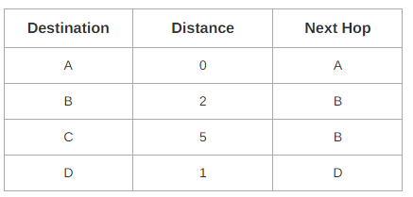
Cost of reaching destination B from router A = min { 2+0 , 1+7 } = 2 via B.
Cost of reaching destination C from router A = min { 2+3 , 1+11 } = 5 via B.
Cost of reaching destination D from router A = min { 2+7 , 1+0 } = 1 via D.
Thus, the new routing table at router A is-

Slide 72
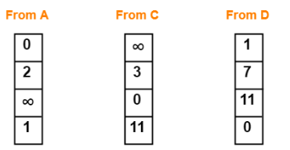
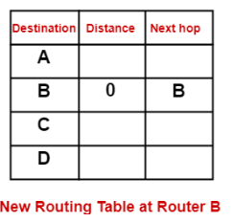
At Router B-
Router B receives distance vectors from its neighbors A, C and D.
Router B prepares a new routing table as-
Cost of reaching destination A from router B = min { 2+0 , 3+∞ , 7+1 } = 2 via A.
Cost of reaching destination C from router B = min { 2+∞ , 3+0 , 7+11 } = 3 via C.
Cost of reaching destination D from router B = min { 2+1 , 3+11 , 7+0 } = 3 via A.

Slide 73
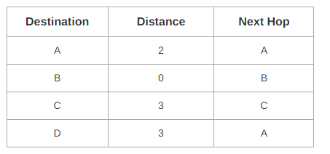
Thus, the new routing table at router B is-
At Router C-
Router C receives distance vectors from its neighbors B and D.
Router C prepares a new routing table as-

Slide 74
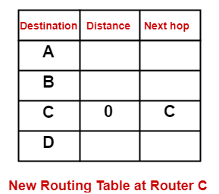
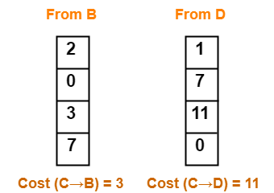
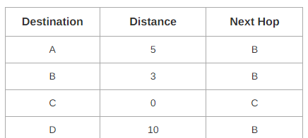
At router C
Cost of reaching destination A from router C = min { 3+2 , 11+1 } = 5 via B.
Cost of reaching destination B from router C = min { 3+0 , 11+7 } = 3 via B.
Cost of reaching destination D from router C = min { 3+7 , 11+0 } = 10 via B.
Thus, the new routing table at router C is-

Slide 75
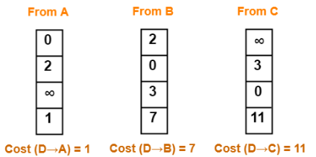


At Router D-
Router D receives distance vectors from its neighbors A, B and C.
Router D prepares a new routing table as-
Cost of reaching destination A from router D = min { 1+0 , 7+2 , 11+∞ } = 1 via A.
Cost of reaching destination B from router D = min { 1+2 , 7+0 , 11+3 } = 3 via A.
Cost of reaching destination C from router D = min { 1+∞ , 7+3 , 11+0 } = 10 via B.
Thus, the new routing table at router D is-

Slide 76



Step-03:
Each router exchanges its distance vector obtained in Step-02 with its neighboring routers.
After exchanging the distance vectors, each router prepares a new routing table.
At Router A-
Router A receives distance vectors from its neighbors B and D.
Router A prepares a new routing table as-
Cost of reaching destination B from router A = min { 2+0 , 1+3 } = 2 via B.
Cost of reaching destination C from router A = min { 2+3 , 1+10 } = 5 via B.
Cost of reaching destination D from router A = min { 2+3 , 1+0 } = 1 via D.

Slide 77


Thus, the new routing table at router A is-
At Router B-
Router B receives distance vectors from its neighbors A, C and D.
Router B prepares a new routing table as-
Cost of reaching destination A from router B = min { 2+0 , 3+5 , 3+1 } = 2 via A.
Cost of reaching destination C from router B = min { 2+5 , 3+0 , 3+10 } = 3 via C.
Cost of reaching destination D from router B = min { 2+1 , 3+10 , 3+0 } = 3 via A.

Slide 78


Thus, the new routing table at router B is-
The algorithm keeps on repeating periodically and never stops.
This is to update the shortest path in case any link goes down or topology changes.

Slide 79

Count to infinity problem:
One of the important issue in Distance Vector Routing is County of Infinity Problem.
Counting to infinity is just another name for a routing loop.
In distance vector routing, routing loops usually occur when an interface goes down.
It can also occur when two routers send updates to each other at the same time.
The reason for the count-to-infinity problem is that each node only has a “next-hop-view”

Slide 80



Assume distance between each is 1 unit

Slide 81

Consider 5 routers arranged in the following topology
When A is down
After A comes up

Slide 82

`
The routers go on feeding each other bad information toward infinity which is called as Count to Infinity problem.
Problem with distance vector routing is whenever a link is broken , other routers unknowingly given information that they know how to reach a disconnected node. This false information will propagate to all routers . This problem is known as count to infinity.

Slide 83


In link state routing, if each node in the domain has the entire topology of the domain the list of nodes and links, how they are connected including the type, cost (metric), and condition of the links (up or down)

Slide 84


The topology must be dynamic, representing the latest state of each node and each link. If there are changes in any point in the network (a link is down, for example), the topology must be updated for each node.

Slide 85
Node A knows that it is connected to node B with metric 5, to node C with metric 2, and to node D with metric 3. Node C knows that it is connected to node A with metric 2, to node B with metric 4, and to node E with metric 4. Node D knows that it is connected only to node A with metric 3. And so on.
A tree is a graph of nodes and links; one node is called the root. All other nodes can be reached from the root through only one single route. A shortest path tree is a tree in which the path between the root and every other node is the shortest.
The algorithm divides the nodes into two sets: tentative and permanent. It finds the neighbors of a current node, makes them tentative, examines them, and if they pass the criteria, makes them permanent.

Slide 86


Slide 87
We make node A the root of the tree and move it to the tentative list. Our two lists are Permanent list: empty ; Tentative list: A(0)
Node A has the shortest cumulative cost from all nodes in the tentative list. We move A to the permanent list and add all neighbors of A to the tentative list. Our new lists are Permanent list: A(0); Tentative list: B(5), C(2), D(3)
Node C has the shortest cumulative cost from all nodes in the tentative list. We move C to the permanent list. Node C has three neighbors, but node A is already processed, which makes the unprocessed neighbors just B and E. However, B is already in the tentative list with a cumulative cost of 5. Node A could also reach node B through C with a cumulative cost of 6. Since 5 is less than 6, we keep node B with a cumulative cost of 5 in the tentative list and do not replace it. Our new lists are Permanent list: A(O), C(2); Tentative list: B(5), D(3), E(6)
Node D has the shortest cumulative cost of all the nodes in the tentative list. We move D to the permanent list. Node D has no unprocessed neighbor to be added to the tentative list. Our new lists are Permanent list: A(O), C(2), D(3); Tentative list: B(5), E(6)

Slide 88
Node B has the shortest cumulative cost of all the nodes in the tentative list. We move B to the permanent list. We need to add all unprocessed neighbors of B to the tentative list (this is just node E). However, E(6) is already in the list with a smaller cumulative cost. The cumulative cost to node E, as the neighbor of B, is 8. We keep node E(6) in the tentative list. Our new lists are Permanent list: A(0), B(5), C(2), D(3); Tentative list: E(6)
Node E has the shortest cumulative cost from all nodes in the tentative list. We move E to the permanent list. Node E has no neighbor. Now the tentative list is empty. We stop; our shortest path tree is ready. The final lists are Permanent list: A(0), B(5), C(2), D(3), E(6); Tentative list: empty

Slide 89







Slide 90


Slide 91
Eg 2
Routing Table for A
Prepare a permanent list and temporary list
PL TL
A(0)
A(0) B(2) D(1) C(5)
A(0)D(1) B(2) C(4)E(2)
A(0)D(1)E(2) B(2) C(3)F(4)
A(0)D(1)E(2)B(2) C(3)F(4)
A(0)D(1)E(2)B(2)C(3) F(4)
A(0)D(1)E(2)B(2)C(3)F(4) Empty
B
C
2
A
F
1
1
2
D
E
1

Slide 92


Congestion is a situation in Communication Networks in which too many packets are present in a part of the subnet, performance degrades. Congestion in a network may occur when the load on the network (i.e. the number of packets sent to the network) is greater than the capacity of the network (i.e. the number of packets a network can handle.).
Congestion control refers to the techniques used to control or prevent congestion. Congestion control techniques can be broadly classified into two categories:

Slide 93
Open Loop Congestion Control
Open loop congestion control policies are applied to prevent congestion before it happens. The congestion control is handled either by the source or the destination.
Policies adopted by open loop congestion control –
1.Retransmission Policy :
It is the policy in which retransmission of the packets are taken care of. If the sender feels that a sent packet is lost or corrupted, the packet needs to be retransmitted. This transmission may increase the congestion in the network.
To prevent congestion, retransmission timers must be designed to prevent congestion and also able to optimize efficiency.

Slide 94
2 Window Policy :
The type of window at the sender’s side may also affect the congestion. Several packets in the Go-back-n window are re-sent, although some packets may be received successfully at the receiver side. This duplication may increase the congestion in the network and make it worse.
Therefore, Selective repeat window should be adopted as it sends the specific packet that may have been lost.
3. Discarding Policy :
A good discarding policy adopted by the routers is that the routers may prevent congestion and at the same time partially discard the corrupted or less sensitive packages and also be able to maintain the quality of a message.
In case of audio file transmission, routers can discard less sensitive packets to prevent congestion and also maintain the quality of the audio file.

Slide 95
4. Acknowledgment Policy :
Since acknowledgements are also the part of the load in the network, the acknowledgment policy imposed by the receiver may also affect congestion. Several approaches can be used to prevent congestion related to acknowledgment.
The receiver should send acknowledgement for N packets rather than sending acknowledgement for a single packet.
5. Admission Policy :
In admission policy a mechanism should be used to prevent congestion. Switches in a flow should first check the resource requirement of a network flow before transmitting it further. If there is a chance of a congestion or there is a congestion in the network, router should deny establishing a virtual network connection to prevent further congestion.
All the above policies are adopted to prevent congestion before it happens in the network.

Slide 96

Algorithms used for traffic shaping(Open loop)
1.Leaky Bucket Algorithm
It is a traffic shaping mechanism that controls the amount and the rate of the traffic sent to the network.
A leaky bucket algorithm shapes bursty traffic into fixed rate traffic by averaging the data rate.
• Imagine a bucket with a small hole at the bottom.

Slide 97

Also, when the bucket is full, any additional water that enters into the bucket spills over the sides and is lost.
• The same concept can be applied to packets in the network. Consider that data is coming from the source at variable speeds. Suppose that a source sends data at 12 Mbps for 4 seconds. Then there is no data for 3 seconds. The source again transmits data at a rate of 10 Mbps for 2 seconds. Thus, in a time span of 9 seconds, 68 Mb data has been transmitted.
If a leaky bucket algorithm is used, the data flow will be 8 Mbps for 9 seconds. Thus constant flow is maintained.

Slide 98

A leaky bucket algorithm does not consider the idle time of the host. For example, if the host was idle for 10 seconds and now it is willing to sent data at a very high speed for another 10 seconds, the total data transmission will be divided into 20 seconds and average data rate will be maintained. The host is having no advantage of sitting idle for 10 seconds.
To overcome this problem, a token bucket algorithm is used. A token bucket algorithm allows bursty data transfers.
A token bucket algorithm is a modification of leaky bucket in which bucket contains tokens.
In this algorithm, a token(s) are generated at every clock tick. For a packet to be transmitted, system must remove token(s) from the bucket.

Slide 99

Ex 1
In figure (a) the bucket holds two tokens, and three packets are waiting to be sent out of the interface.
In Figure (b) two packets have been sent out by consuming two tokens, and 1 packet is still left.

Slide 100

Thus, a token bucket algorithm allows idle hosts to accumulate credit for the future in form of tokens.
For example, if a system generates 100 tokens in one clock tick and the host is idle for 100 ticks. The bucket will contain 10,000 tokens.
Now, if the host wants to send bursty data, it can consume all 10,000 tokens at once for sending 10,000 cells or bytes.
Thus a host can send bursty data as long as bucket is not empty.

Slide 101

What is ARP ?
The host and routers are identified at the network layer by their IP addresses.
IP addresses- unique.
In a n/w (LAN) hosts are identified by their MAC addresses (physical), imprinted on the NIC.
MAC addresses-Unique locally, not universally.
Delivery of a packet to host requires two addressss (IP, MAC).
Domain names are used to identify the destination.
DNS- Maps names to IP addresses.
Hence IP address of destination is known.
Not known – MAC Address

Slide 102

ARP maps an IP address to its physical address.
Anytime a host, or a router, needs to find the MAC address of another host or router on a network, it sends an ARP query packet.
The packet includes the physical and IP address of the sender and the IP address of the receiver.
Because the sender doesn’t know the physical address of the receiver, the query is broadcast over the network.
Every host on the network receives and processes the ARP query packet, but only the intended recipient recognizes its IP address and sends back an ARP response packet.
The response packet contains the recipient’s IP and MAC addresses and is unicast directly back to the inquirer using the physical address received in the query packet.

Slide 103

ARP OPERATION

Slide 104


Case 1: The sender is a host and wants to send a packet to another host on the same network.
Use ARP to find another host’ s physical address

Slide 105

Four Cases to Use ARP
Case 2: The sender is a host and wants to send a packet to another host on another network
Sender looks at its routing table
Find the IP address of the next hop (router) for this destination
Use ARP to find the router ’ s physical address

Slide 106

Case 3: the sender is a router and received a datagram destined for a host on another network
Router check its routing table
Find the IP address of the next router
Use ARP to find the next router ’ s physical address

Slide 107

Case 4: the sender is a router that has received a datagram destined for a host in the same network
Use ARP to find this host’ s physical address

Slide 108
Each time an ARP message is sent by a device, this ties up the network by consuming some bandwidth.
Moreover, when each ARP message is broadcast, every device on the network will spare some CPU time to examine the content of those messages.
Solution :
USE ARP CACHE

Slide 109
When a host A receives a reply resolving the IP address to MAC address of host B. The mapping is saved by the host in it’s memory.
This memory is called the ARP cache.
Hence if in future the MAC address of the same host(B), whose address has been resolved is needed in future by host A, A quickly looks up in it’s cache.
This means that instead of doing a broadcast every time there is a request, the broadcast is only done once.

Slide 110
Contents of the ARP Cache:
(128.143.71.37) at 00:10:4B:C5:D1:15
(128.143.71.36) at 00:B0:D0:E1:17:D5
(128.143.71.35) at 00:B0:D0:DE:70:E6
(128.143.136.90) at 00:05:3C:06:27:35
(128.143.71.34) at 00:B0:D0:E1:17:DB
(128.143.71.33) at 00:B0:D0:E1:17:DF

Slide 111

A diskless machine is usually booted from ROM.
It cannot include the IP address
IP address are assigned by the network administrator
Obtain its logical address by the physical address using the RARP protocol

Slide 112



